Slide 1

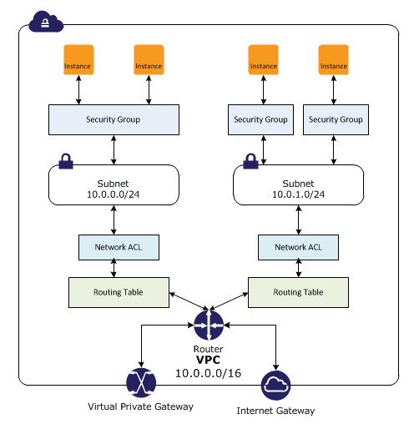
https://aws.amazon.com/about-aws/global-infrastructure/
NETWORKING
WHAT is Virtual Private Cloud?
Key concepts are:
VPC
Router
Routing Table
Network ACL
Subnet
Security Groups
Instance

Slide 2
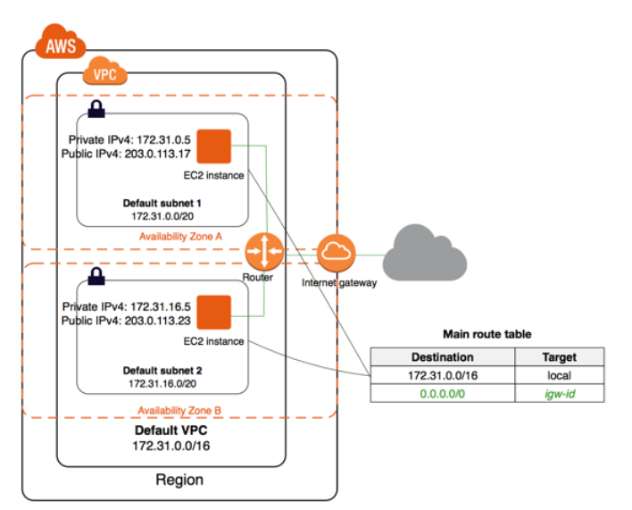
VIRTUAL PRIVATE CLOUD
A virtual network for an organization.
It has an CIDR range.
It can have many subnets.
There are Default and Non Default VPC’s.
Access to internet using Internet Gateways
Have public and private subnets.

Slide 3
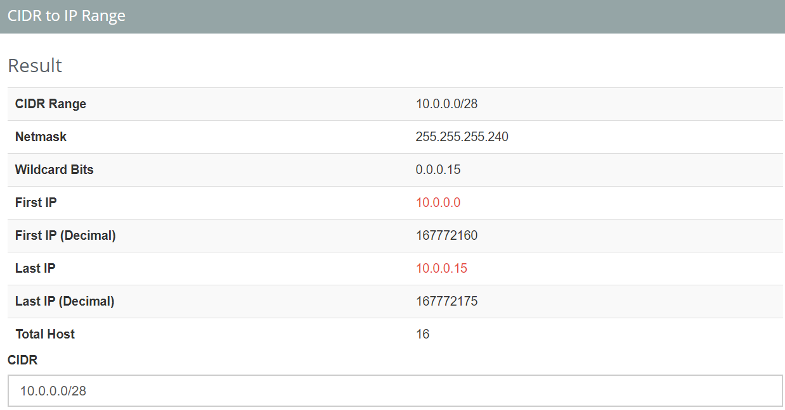
Classless interdomain routing
10.0.0.0 / 28
0000 1010 0000 0000 0000 0000 0000 0000
0000 1010 0000 0000 0000 0000 0000 1111
https://www.ipaddressguide.com/cidr

Slide 4
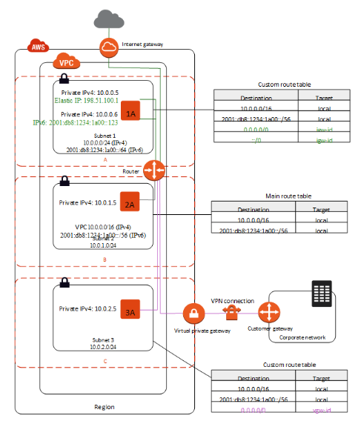
Subnets
Grouping of a range of IP’s in a availability zone.
Attached to a routing table
Public subnet has an Internet Gateway
Private subnet does not connect to Internet
An Virtual Private Subnet will have a virtual private gateway.

Slide 5
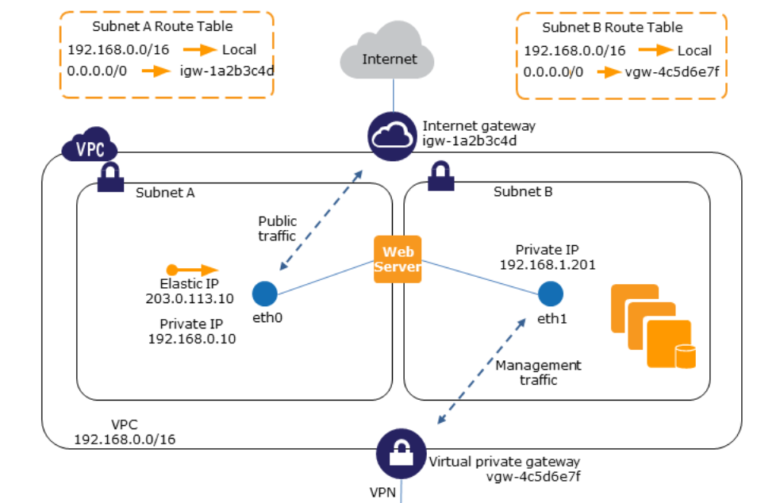
Networking interfaces

Slide 6
Routing table
Information on routing process at the subnet level
There is 1 default subnet for the default VPC
Specific route table can be created
Target can be
Internet Gateway
Virtual Private Gateway
Subnet – CIDR Block ( Internal)
ENI Device…
Routing follows process = highest specific to lowest specific

Slide 7
Networking interfaces
Information about network connection to EC2.
1 or more interfaces possible
Security-Group attached.
Instance logging using VPC flow logs
Public IP access comes from the subnet.
Can move Network Interface across instances

Slide 8
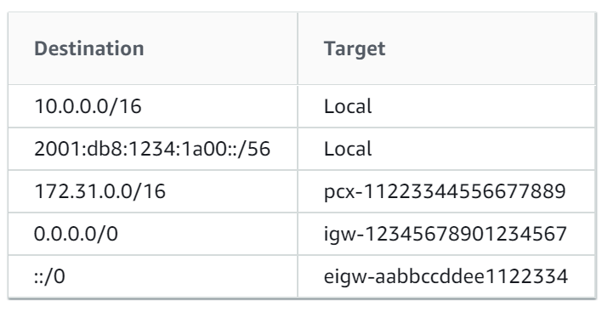
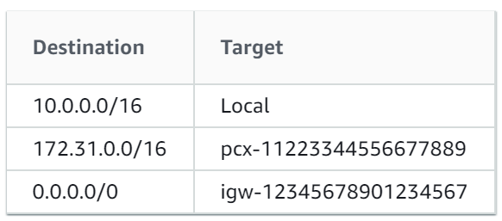
Routing table
https://www.site24x7.com/tools/ipv4-subnetcalculator.html

Slide 9
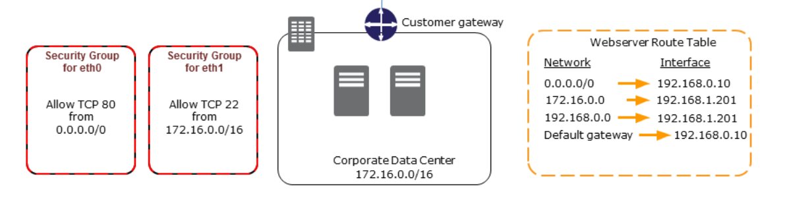
Networking interfaces

Slide 10
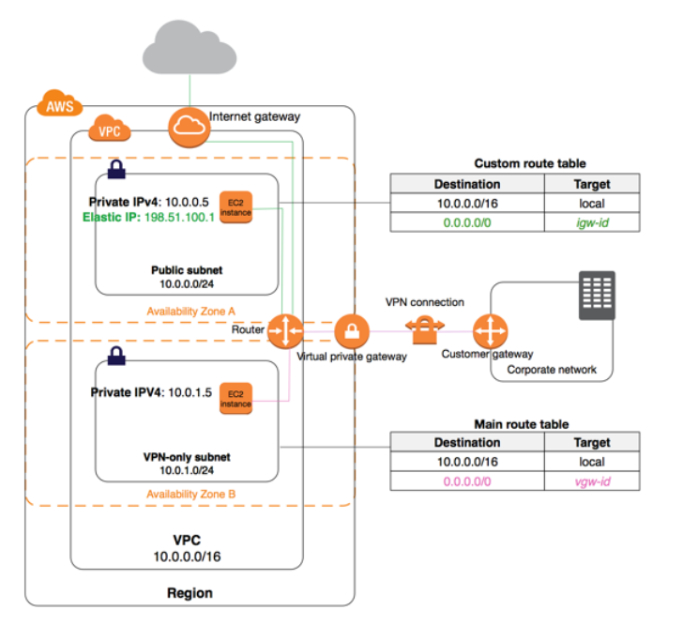
Routing table

Slide 11
Security groups
Stateful control of traffic flow in EC2 instance
1 instance to many security group → cumulative results
Default all outbound allowed.
Source and destination can be IP, CIDR and Security Groups
Network connection is tracked when inbound request is created
Security group can be changed during running status of instance.
Existing connections will also be updated.

Slide 12
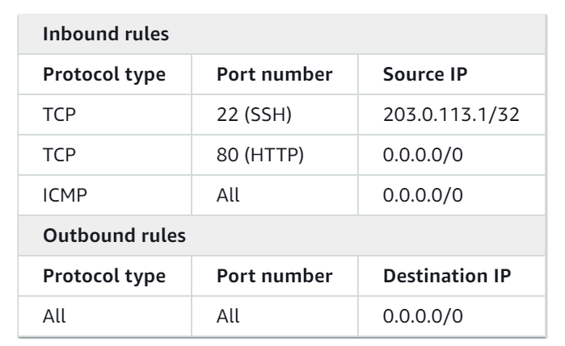
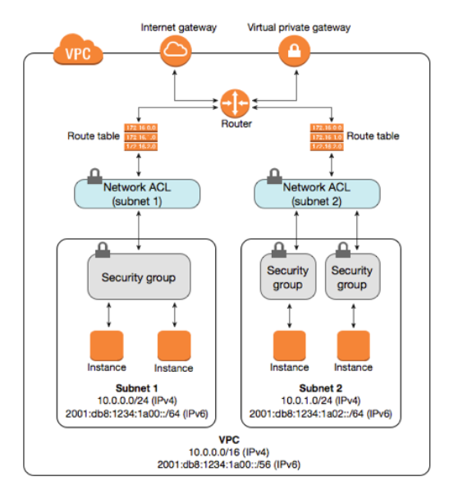
Security groups

Slide 13
Access control lists
Access control list connected at the subnet level
1 Access control goes to more than 1 subnets
It is a stateless, we have to manage both the inbound and the outbound connections.
We have to give both the inbound and the outbound access rules which are important.
Default access rule “*” is deny all.
Deny rules have to come first and then allow rules.

Slide 14
Access control lists
Rule # | Type | Protocol | Port | Range | Allow/Deny | Comments
100 | HTTP | TCP | 80 | 0.0.0.0/0 | ALLOW | Allows inbound HTTP traffic from any IPv4 address.
105 | HTTP | TCP | 80 | ::/0 | ALLOW | Allows inbound HTTP traffic from any IPv6 address.
110 | HTTPS | TCP | 443 | 0.0.0.0/0 | ALLOW | Allows inbound HTTPS traffic from any IPv4 address.
115 | HTTPS | TCP | 443 | ::/0 | ALLOW | Allows inbound HTTPS traffic from any IPv6 address.
120 | SSH | TCP | 22 | 192.0.2.0/24 | ALLOW | Allows inbound SSH traffic from your home network's public IPv4 address range (over the internet gateway).
130 | RDP | TCP | 3389 | 192.0.2.0/24 | ALLOW | Allows inbound RDP traffic to the web servers from your home network's public IPv4 address range (over the internet gateway).
140 | Custom TCP | TCP | 32768-65535 | 0.0.0.0/0 | ALLOW | Allows inbound return IPv4 traffic from the internet (that is, for requests that originate in the subnet).
* | All traffic | All | All | 0.0.0.0/0 | DENY | Denies all inbound IPv4 traffic not already handled by a preceding rule (not modifiable).

Slide 15
Access control lists
Rule # | Type | Protocol | Port | Range | Allow/Deny | Comments
100 | HTTP | TCP | 80 | 0.0.0.0/0 | ALLOW | Allows outbound IPv4 HTTP traffic from the subnet to the internet.
105 | HTTP | TCP | 80 | ::/0 | ALLOW | Allows outbound IPv6 HTTP traffic from the subnet to the internet.
110 | HTTPS | TCP | 443 | 0.0.0.0/0 | ALLOW | Allows outbound IPv4 HTTPS traffic from the subnet to the internet.
120 | Custom TCP | TCP | 32768-65535 | 0.0.0.0/0 | ALLOW | Allows outbound IPv4 responses to clients on the internet (for example, serving webpages to people visiting the web servers in the subnet).

Slide 16
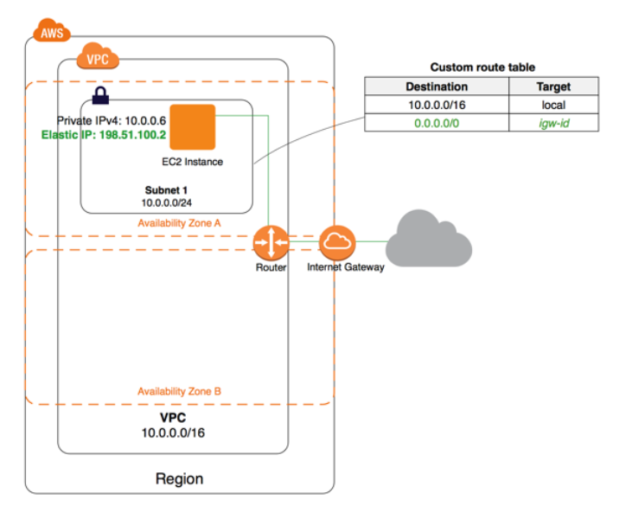
INTERNET GATEWAY
Connection of an EC2 instance to the Internet.
Directs inbound requests into Gateway to the private ip
Directs the outbound requests, return address to the public ip or the elastic ip.
It is attached to the routing table which is attached to subnet to decide the type of the subnet: public or private.

Slide 17
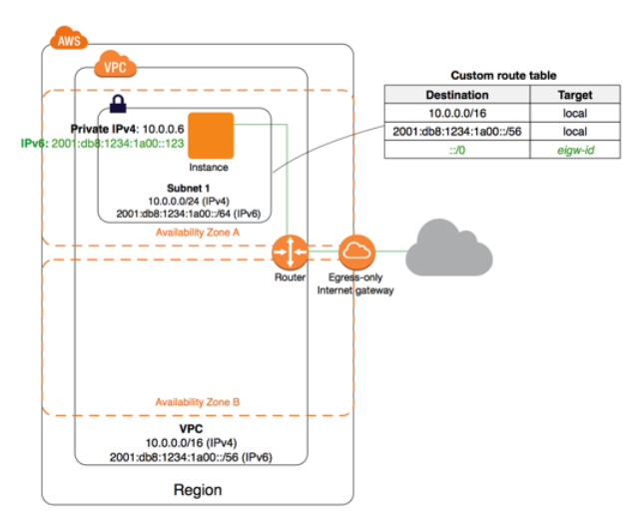
Egress only
internet gateways
Egress internet gateways is the outbound only requests for IpV6 and not for IpV4
We have to attach them to the route table

Slide 18
DHcp options set
Default public and private FQDN is provided.
Upto 4 DHCP option set can be attached to use custom DNS provider for the instances
This can be used in Big data environments.

Slide 19
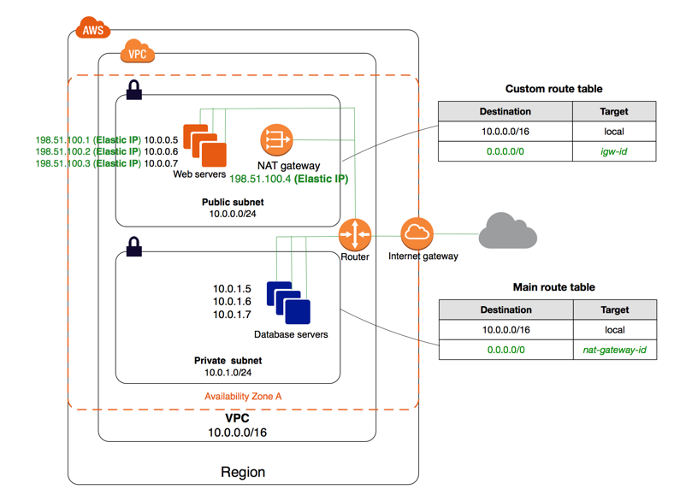
Nat gateways
Provide network translation on only outbound and its corresponding inbound results.
No direct inbound will be allowed into the subnet attached to Nat Gateway.
It is attached to Elastic IP address.
If no longer used, Elastic IP still remains.
It is charged on hourly basis.

Slide 20
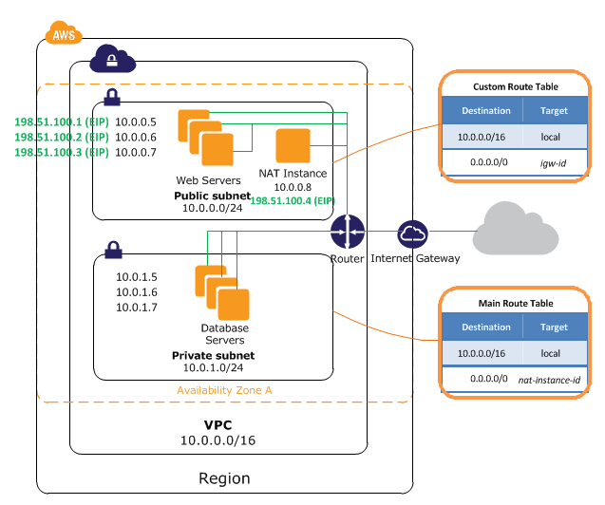
nAT INSTANCES
NAT instances are used for the connection for outbound in the public subnet.
NAT instances are special type of AMIs
The NAT instance is attached to the route table.

Slide 21
Elastic IP
Permanent IP address which is available to VPC
Upto 5 Elastic IP’s
Small rate charged when elastic IP is not used
Ensures non changed public IP
Can be used with NAT Gateways

Slide 22
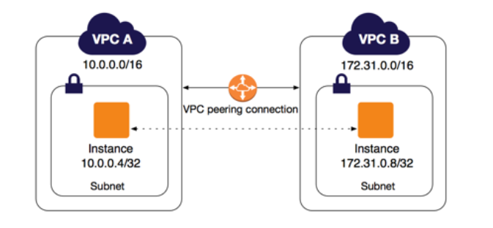
Peering connections
Connect from 1 VPC to another in the same account.
It is cost effective and entire solution is managed in AWS.

Slide 23
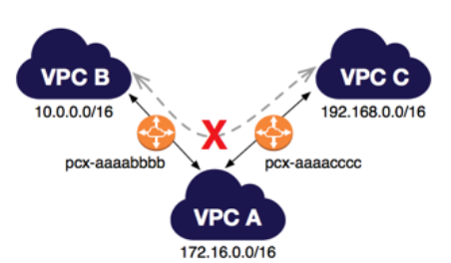
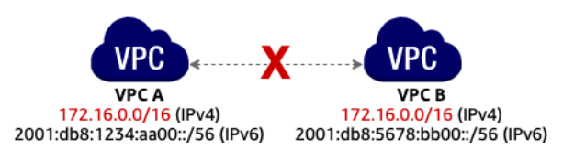
Peering connections
Transitive peering and overlapping CIDR blocks are not supported.

Slide 24
End points

Slide 25
End point services

Slide 26
DESIGN A BASTION AND
INSTANCES GROUP

